Slide 1
Chapter 1
Concept 2

Slide 2
Section III–Presenting Your Results
A. Displaying Data on the Front Panel
Controls and Indicators
Graphs and Charts
Loop Timing
B. Signal Processing
LabVIEW MathScript
Arrays
Clusters
Waveforms
Notes:
Introduction to LabVIEW Hands-On 52 ni.com

Slide 3
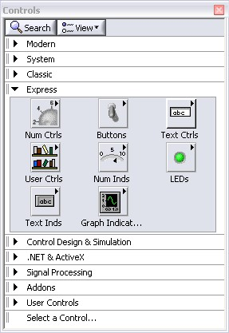
What Types of Controls and Indicators Are Available?
Numeric Data
Number Input and Display
Analog Sliders, Dials, and Gauges
Boolean Data
Buttons and LEDs
Array and Matrix Data
Numeric Display
Chart
Graph
XY Graph
Intensity Graph
3D Graph: Point, Surface, and Model
Decorations
Tab Control
Arrows
Other
Strings and Text Boxes
Picture/Image Display
ActiveX Controls
Express Controls Palette
Notes:
Controls and indicators are front panel items that you can use to interact with your program to provide input and display results. You can access controls and indicators by right-clicking the front panel.
In addition, you obtain additional controls and indicators when you install toolkits and modules.
For example, when you install the control design tools, you can use specialized plots, such as Bode and Nyquist, plots that are not available by default.
© National Instruments Corporation 53 Introduction to LabVIEW Hands-On

Slide 4
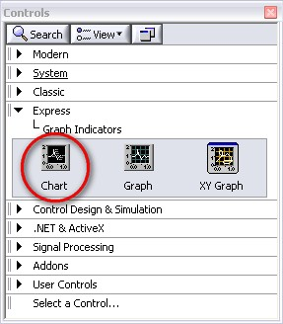
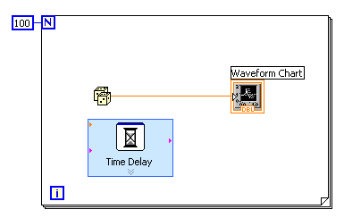
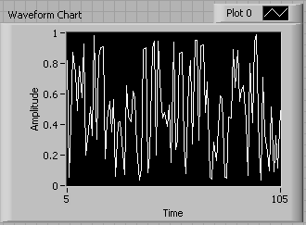
Charts – Add 1 Data Point at a Time with History
Waveform chart – special numeric indicator that can display a history of values
Chart updates with each individual point it receives
Controls»Express»Graph Indicators»Chart
Notes:
The waveform chart is a special numeric indicator that displays one or more plots. It is located on the Controls»Modern»Graph palette. Waveform charts can display single or multiple plots. The following front panel shows an example of a multiplot waveform chart.
You can change the minimum and maximum values of either the x-axis or y-axis axis by double-clicking on the value with the labeling tool and typing the new value. Similarly, you can change the label of the axis. You can also right-click the plot legend and change the style, shape, and color of the trace that is displayed on the chart.
Introduction to LabVIEW Hands-On 54 ni.com

Slide 5
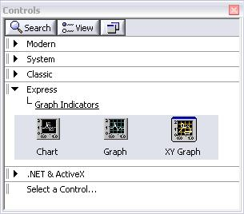
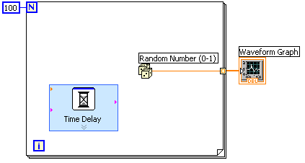
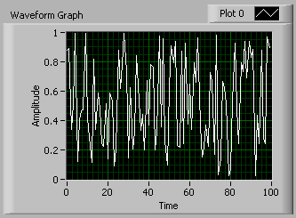
Graphs – Display Many Data Points at Once
Waveform graph – special numeric indicator that displays an array of data
Graph updates after all points have been collected
May be used in a loop if VI collects buffers of data
Controls»Express»Graph Indicators»Graph
Notes:
Graphs are very powerful indicators in LabVIEW. You can use these highly customizable tools to concisely display a great deal of information.
With the properties page of the graph, you can display settings for plot types, scale and cursor options, and many other features of the graph. To open the properties page, right-click the graph on the front panel and choose Properties.
You can also create technical-paper-quality graphics with the “export simplified image” function. Right-click the graph and select Data Operations»Export Simplified Image…
© National Instruments Corporation 55 Introduction to LabVIEW Hands-On

Slide 6
Building Arrays with Loops (Auto-Indexing)
Loops can accumulate arrays at their boundaries with auto-indexing
For loops auto-index by default
While loops output only the final value by default
Right-click tunnel and enable/disable auto-indexing
Auto-Indexing Enabled
Wire becomes thicker
1D Array
0 1 2 3 4 5
Auto-Indexing Disabled
Wire remains the same size
5
Only one value (last iteration) is passed out of the loop
Notes:
For loops and while loops can index and accumulate arrays at their boundaries. This is known as auto-indexing.
The indexing point on the boundary is called a tunnel
The for loop is auto-indexing-enabled by default
The while loop is auto-indexing-disabled by default
Examples:
Enable auto-indexing to collect values within the loop and build the array. All values are placed in the array upon exiting the loop.
Disable auto-indexing if you are interested only in the final value.
Introduction to LabVIEW Hands-On 56 ni.com

Slide 7
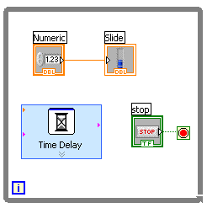
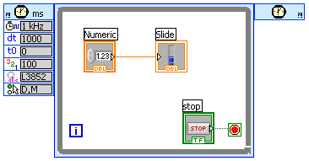
How Do I Time a Loop?
1. Loop Time Delay
Configure the Time Delay Express VI for seconds to wait each iteration of the loop (works on for and while loops).
2. Timed Loops
Configure special timed while loop for desired dt.
Time Delay
Timed Loop
Notes:
Time Delay
The Time Delay Express VI delays execution by a specified number of seconds. Following the rules of dataflow programming, the while loop does not iterate until all tasks inside of it are complete, thus delaying each iteration of the loop.
Timed Loops
Executes each iteration of the loop at the period you specify. Use the timed loop when you want to develop VIs with multirate timing capabilities, precise timing, feedback on loop execution, timing characteristics that change dynamically, or several levels of execution priority.
Double-click the Input Node or right-click the Input Node and select Configure Timed Loop from the shortcut menu to display the Loop Configuration dialog box, where you can configure the timed loop. The values you enter in the Loop Configuration dialog box appear as options in the Input Node.
Wait Until Next ms Multiple
This function waits until the value of the millisecond timer becomes a multiple of the specified millisecond multiple to help you synchronize activities. You can call this function in a loop to control the loop execution rate. However, it is possible that the first loop period might be short. This function makes asynchronous system calls, but the nodes themselves function synchronously. Therefore, it does not complete execution until the specified time has elapsed. This function can be found at Functions»Programming»Timing»Wait Until Next ms Multiple
© National Instruments Corporation 59 Introduction to LabVIEW Hands-On

Slide 8
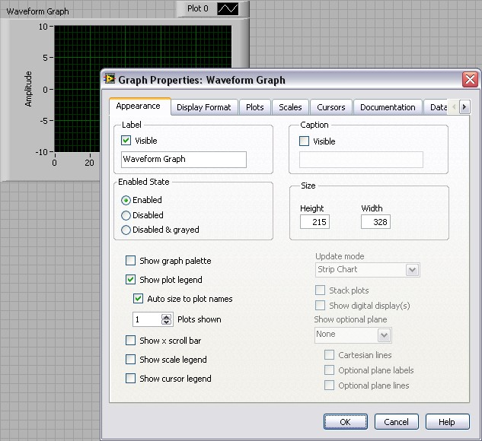
Control and Indicator Properties
Properties are characteristics or qualities about an object
Properties can be found by right-clicking on a control or indicator
Properties include:
Size
Color
Plot style
Plot color
Features include:
Cursors
Scaling
Notes:
Properties are all the qualities of a front panel object. With properties, you can set or read such characteristics as foreground and background color, data formatting and precision, visibility, descriptive text, size and location on the front panel, and so on.
Introduction to LabVIEW Hands-On 60 ni.com

Slide 9
Textual Math in LabVIEW
Integrate existing scripts with LabVIEW for faster development
Use Interactive, easy-to-use, hands-on learning environment
Develop algorithms, explore mathematical concepts, and analyze results using a single environment
Freedom to Choose the most effective syntax, whether graphical or textual within one VI
MATLAB ® is a registered trademark of The MathWorks, Inc.
Notes:
Overview
With the release of LabVIEW 8.6, you have new freedom to choose the most effective syntax for technical computing, whether you are developing algorithms, exploring DSP concepts, or analyzing results. You can instrument your scripts and develop algorithms on the block diagram by interacting with popular third-party math tools such as The MathWorks, Inc. MATLAB® software, Wolfram Mathematica, Maplesoft Maple, MathSoft Mathcad, ITT IDL, and NI Xmath. You can use of these math tools with LabVIEW is achieved in a variety of ways depending on the vendor as listed below:
Native LabVIEW textual math node:
LabVIEW MathScript Node, Formula Node
Communication with vendor software through LabVIEW node:
Xmath node, MATLAB script Node, Maple* Node, IDL* Node
Communication with vendor software through VI Server:
Mathematica* VIs, Mathcad* VIs
In LabVIEW, you can combine the intuitive LabVIEW graphical dataflow programming with LabVIEW MathScript, a math-oriented textual programming language that is generally compatible with popular .m file script language.
*LabVIEW toolkit specific to the math tool must be installed.
Introduction to LabVIEW Hands-On 62 ni.com

Slide 10
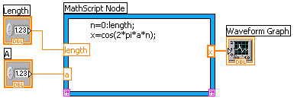
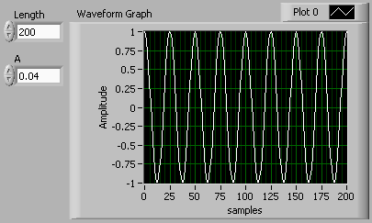
Math with the LabVIEW MathScript Node
Implement equations and algorithms textually
Input and output variables created at the border
Generally compatible with popular .m file script language
Terminate statements with a semicolon to disable immediate output
(Functions»Programming» Structures»MathScript)
Prototype your equations in the interactive LabVIEW MathScript Window.
Notes:
The LabVIEW MathScript Node enhances LabVIEW by adding a native text-based language for mathematical algorithm implementation in the graphical programming environment. You can open and use the .m file scripts you’ve written and saved from the LabVIEW MathScript window in the LabVIEW MathScript Node. The .m file scripts you created in other math software generally run as well. With LabVIEW MathScript you can pick the syntax you are most comfortable with to solve the problem. You can instrument equations with the LabVIEW MathScript Node for parameter exploration, simulation, or deployment in a final application.
The LabVIEW MathScript Node
Located in the Programming»Structures subpalette.
Resizable box for entering textual computations directly into block diagrams.
To add variables, right-click and choose Add Input or Add Output.
Name variables as they are used in the formula. (Names are case sensitive.)
You can change the data type of the output by right-clicking the input or output node.
Terminate the statements with a semicolon to suppress output.
Right-click on the node to import and export .m files.
© National Instruments Corporation 63 Introduction to LabVIEW Hands-On

Slide 11
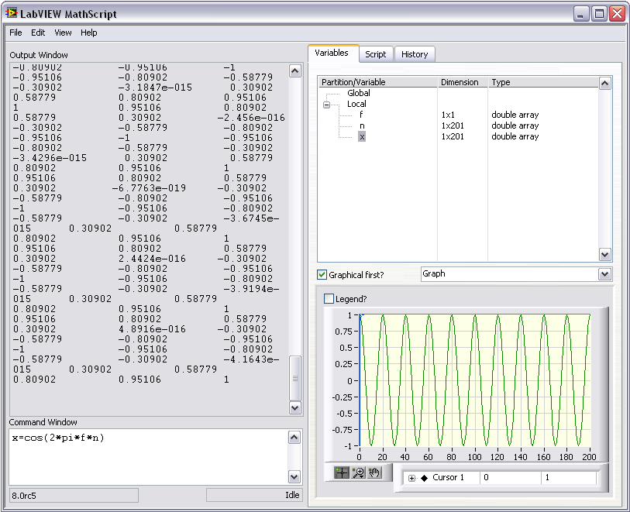
The Interactive LabVIEW MathScript Window
Rapidly develop and test algorithms
Share scripts and variables with the node
View/modify variable content in 1D, 2D, and 3D
Variable
Workspace
Output
Window
View/Modify
Variable Contents
User Commands
.m file Script
(LabVIEW»Tools»MathScript Window)
Notes:
The LabVIEW MathScript window provides an interactive environment where you can prototype equations and make calculations. The MathScript window and MathScript Node share a common syntax and global variables, making the move from prototype to implementation seamless. The data preview pane provides a convenient way to view variable data as numbers, graphically, or audibly (with sound card support).
Help for LabVIEW MathScript
You can access help for the environment using the LabVIEW MathScript interactive environment window. Type Help in the command window for an introduction to LabVIEW MathScript help. Typing Help followed by a function will display help specific to that function.
Features of the interactive MathScript window:
Prototype equations and formulas through the Command Window
Easily access function help by typing Help <function> in the Command Window
Select a variable to display its data in the preview pane and listen to the result
Write, save, load, and run .m files using the Script tab
Share data between the MathScript Node and the MathScript window using global variables
Take advantage of advanced plotting features and image export features
Introduction to LabVIEW Hands-On 64 ni.com

Slide 12
Section IV – Advanced Data flow Topics (Optional)
A. Additional Data Types
Cluster
B. Data flow Constructs
Shift Register
Local Variables
C. Large Application Development
Navigator Window
LabVIEW Projects
Notes:
© National Instruments Corporation 69 Introduction to LabVIEW Hands-On

Slide 13
Introduction to Clusters
Data structure that groups data together
Data may be of different types
Analogous to struct in ANSI C
Elements must be either all controls or all indicators
Thought of as wires bundled into a cable
Order is important
Notes:
Clusters group like or unlike components together. They are equivalent to a record in Pascal or a struct in ANSI C.
Cluster components may be of different data types.
Examples:
Error information - Grouping a Boolean error flag, a numeric error code, and an error source string to specify the exact error.
User information - Grouping a string indicating a user’s name and an ID number specifying the user’s security code.
All elements of a cluster must be either controls or indicators. You cannot have a string control and a Boolean indicator. Think of clusters as grouping individual wires (data objects) together into a cable (cluster).
Introduction to LabVIEW Hands-On 70 ni.com

Slide 14

Cluster Functions
In the Cluster & Variant subpalette of the Programming palette
Can also be accessed by right-clicking the cluster terminal
Bundle
(Terminal labels reflect data type)
Bundle By Name
Notes:
The terms bundle and cluster are closely related in LabVIEW.
Example: You use a bundle function to create a cluster. You use an unbundle function to extract the parts of a cluster.
Bundle - Forms a cluster containing the given objects in the specified order.
Bundle by Name - Updates specific cluster object values (the object must have an owned label).
Unbundle - Splits a cluster into each of its individual elements by data type.
Unbundle by Name - Returns the cluster elements whose names you specify.
Note: You must have an existing cluster wired into the middle terminal of the function to use Bundle By Name.
Introduction to LabVIEW Hands-On 72 ni.com

Slide 15
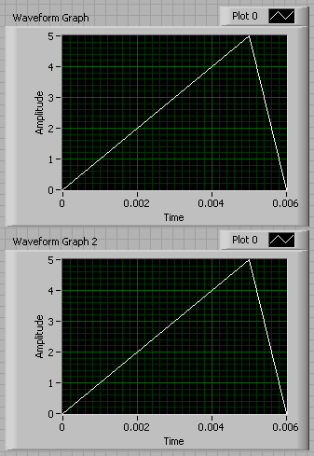
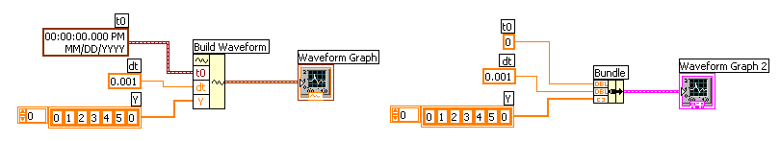
Using Arrays and Clusters with Graphs
The waveform data type contains 3 pieces of data:
t0 = Start time
dt = Time between samples
Y = Array of Y magnitudes
You can create a waveform cluster in two ways:
Build Waveform (absolute time)
Cluster (relative time)
Notes:
The waveform data type carries the data, start time, and ∆t of a waveform. You can create waveforms using the Build Waveform function. Many of the VIs and functions you use to acquire or analyze waveforms accept and return the waveform data type by default. When you wire a waveform data type to a waveform graph or chart, the graph or chart automatically plots a waveform based on the data, start time, and ∆x of the waveform. When you wire an array of waveform data types to a waveform graph or chart, the graph or chart automatically plots all the waveforms.
Build Waveform
Builds a waveform or modifies an existing waveform with the start time represented as an absolute timestamp. Timestamps are accurate to real-world time and date and are very useful for real-world data recording.
Bundle
Builds a waveform or modifies an existing waveform with a relative timestamp. The input to t₀ is a DBL. By building waveforms using the bundle, you can plot data on the negative x-axis (time).
© National Instruments Corporation 73 Introduction to LabVIEW Hands-On

Slide 16
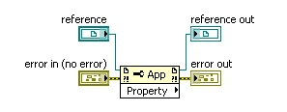
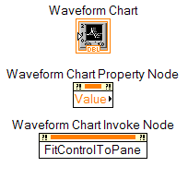
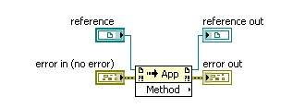
Property and Invoke Nodes
Create Property and Invoke nodes for a VI element by right-clicking the element and selecting Create»Property Node.
Use the Property Node to get and set object properties.
Invoke object methods with the Invoke Node.
Notes:
The Property and Invoke nodes provide an interface for controlling objects from LabVIEW. The object can be an ActiveX object or a reference to a VI through the VI Server.
You can create Property and Invoke nodes using two methods. The first is to right-click on the object and select Create»Property Node. This is good for setting properties and accessing methods of VI elements within that VI. The second method is to place a Property Node or Invoke Node from the Programming»Application Control menu. This is best for accessing the properties and methods of outside applications and VIs because these nodes can take a reference input. You can expand these nodes to read or write to multiple properties and methods at once.
You can use the Property Node to get and set object properties. For instance, if you need your program to reset a control on your front panel, you can create a property node for that control that accesses the “Value” property (right-click and select Create»Property Node»Value). By doing this, you can either read the value of that control or change that property if you change the Property Node to Write mode.
Use the Invoke Node to invoke methods of an object. These methods can include information about an application or ActiveX control, such as version number, or default actions that the object can perform.
Introduction to LabVIEW Hands-On 77 ni.com

Slide 17
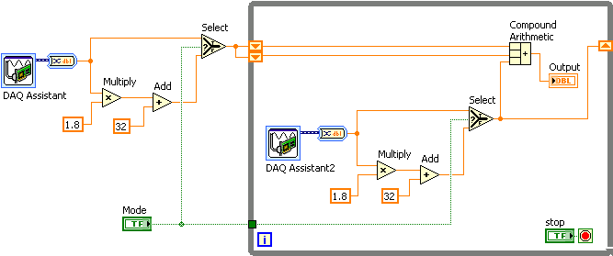
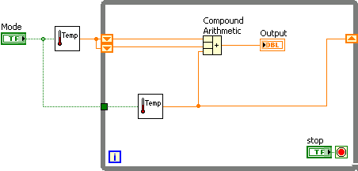
Modularity in LabVIEW – SubVIs
Convert repeated functions and VIs with a single VI
Notes:
Modularity defines the degree to which your VI is composed of discrete components such that a change to one component has minimal impact on other components. In LabVIEW, these separate components are called subVIs. Creating subVIs from your code increases the readability and reusability of your VIs.
In the upper image, note that the repeated code is allowing the user to choose between temperature scales. Because this portion of the code is identical in both cases, you can create a subVI for it. This makes the code more readable by being less clustered, and it allows you to reuse code easily. The code is far less cluttered now and achieves the exact same functionality. You can easily reuse the temperature scale selection portion of the code in other applications.
You can turn any portion of LabVIEW code into a subVI that can be used by other LabVIEW code.
© National Instruments Corporation 81 Introduction to LabVIEW Hands-On

Slide 18
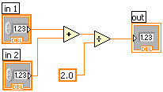
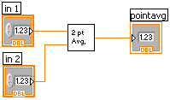
LabVIEW Functions and SubVIs operate like Functions in other languages
Function Pseudo Code
function average (in1, in2, out)
{
out = (in1 + in2)/2.0;
}
SubVI Block Diagram
Calling Program Pseudo Code
main
{
average (in1, in2, pointavg)
}
Calling VI Block Diagram
Notes:
A subVI node corresponds to a subroutine call in text-based programming languages. The node is not the subVI itself, just as a subroutine call statement in a program is not the subroutine itself. A block diagram that contains several identical subVI nodes calls the same subVI several times. The modular approach makes applications easier to debug and maintain. The functionality of the subVI does not matter for this example. The important point is the passing of two numeric inputs and one numeric output.
© National Instruments Corporation 79 Introduction to LabVIEW Hands-On

Slide 19


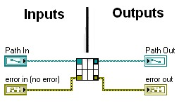
Connector Pane and Icon Viewer
Use this connector pane layout as a standard
Top terminals are usually reserved for file paths and references, such as a file reference
Bottom terminals are usually reserved for error clusters
Notes:
With the connector pane and icon viewer, you can define the data being transferred in and out of the subVI, as well as its appearance in the main LabVIEW code. Every VI displays an icon in the upper-right corner of the front panel and block diagram windows. After you build a VI, build the connector pane and icon so you can use the VI as a subVI.
The icon and connector pane correspond to the function prototype in text-based programming languages. There are many options for the connector pane, but some general standards are specified above. Notably, always reserve the top terminals for references and the bottom terminals for error clusters.
To define a connector pane, right-click the icon in the upper-right corner of the front panel and select Show Connector from the shortcut menu. Each rectangle on the connector pane represents a terminal. Use the terminals to assign inputs and outputs. Select a different pattern by right-clicking the connector pane and selecting Patterns from the shortcut menu.
Introduction to LabVIEW Hands-On 84 ni.com

